Slide 1





Welcome to my presentation on
BANK MANAGEMENT SYSTEM
Presented by Md Shafikul Islam

Slide 2

University of Global Village(UGV)
Department of Computer Science & Engineering
Project Name: Bank Management System
Submitted To :
Md Riadul Islam
Md Mahadi Hasan Shaon
Lecturer,Department of CSE
University of Global Village(UGV), Barishal
Submitted By :
Md Shafikul Islam
4th Semester(Evening)
Student ID: 12112038
Session:Winter-2021
B.Sc. in Computer Science & Engineering

Slide 3


Bank Management System
Page 03
Project Details and Technology
Project Title: Bank Management System
Programming Language Used: C++
Code Editors & IDE : Codeblocks and VSCode
Databases : File System
Project Type : Console Based Application
Developer Name : Md Shafikul Islam
Source Code:https://github.com/mdshafikulislam/Bank-Management-System

Slide 4

Bank Management System
Page 04
Introduction
Bank Management System is based on the concept of recording customer's account details. Here the user can perform all the tasks like creating an account, deposit amount, withdraw amount, checking balance, viewing all account holder's detail, closing an account and modify an account. There is login systems for this project.

Slide 5





Bank Management System
Page 05
Objective of the Project
The proposed system is used to provide banking solutions to customers and banks. it will automate some of the basic operations of a bank. The scope would be to provide basic functionalities using an application so that those manual processes can be automated. It will include providing user-specific access to customers.

Slide 6
Bank Management System
Page 06
Major Functionalities
Login System
Open an Account
Deposit Amount
Withdraw
Balance Check
Show All Account list
Close Account
Modify Account
Quit

Slide 7
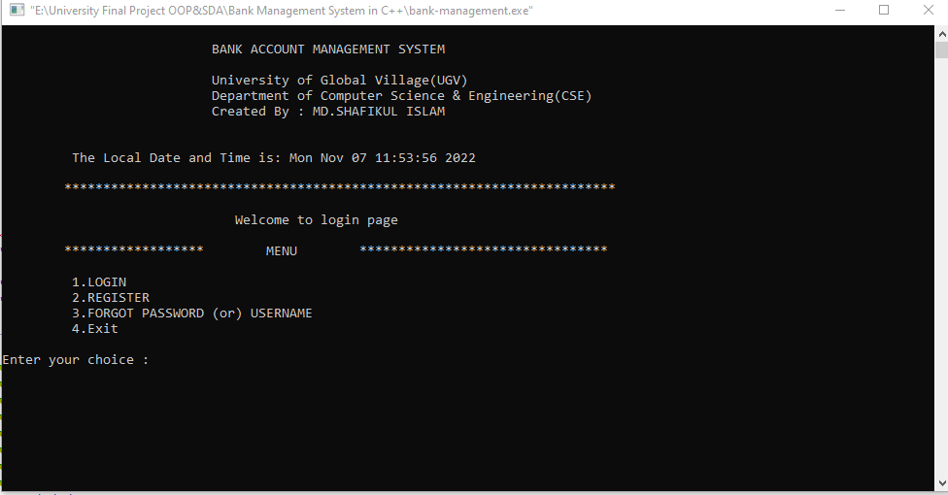

Bank Management System
Page 07
Login System of Bank Management System

Slide 8
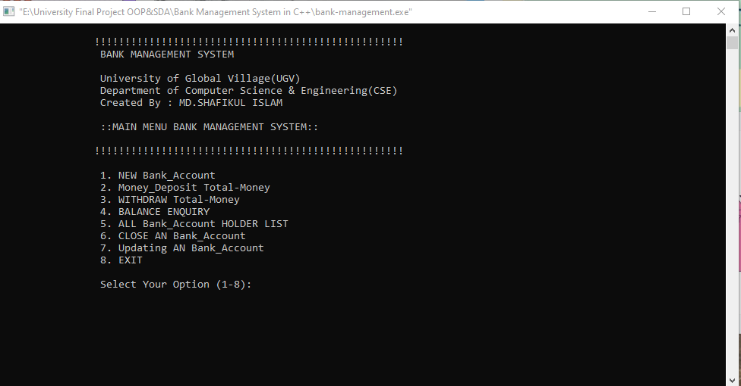
Bank Management System
Page 08
Main Menu of Bank Management System

Slide 9
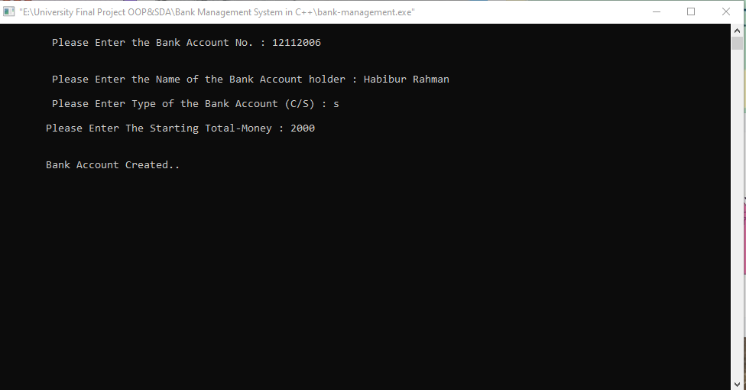
Bank Management System
Page 09
Creating the bank account for the customer
Opens a new account for the user by accepting input such as account number, name and minimum balance, and account type.

Slide 10
Bank Management System
Page 10
Deposit amount for the customer
Provides options to Deposit the amount from the given account number.

Slide 11
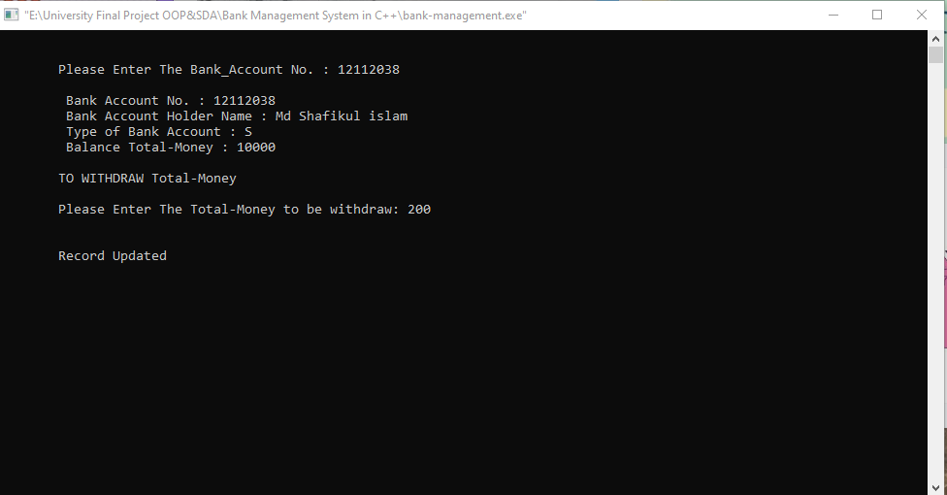
Bank Management System
Page 11
Withdraw amount for the customer
Provides options to Withdraw the amount from the given account number.

Slide 12
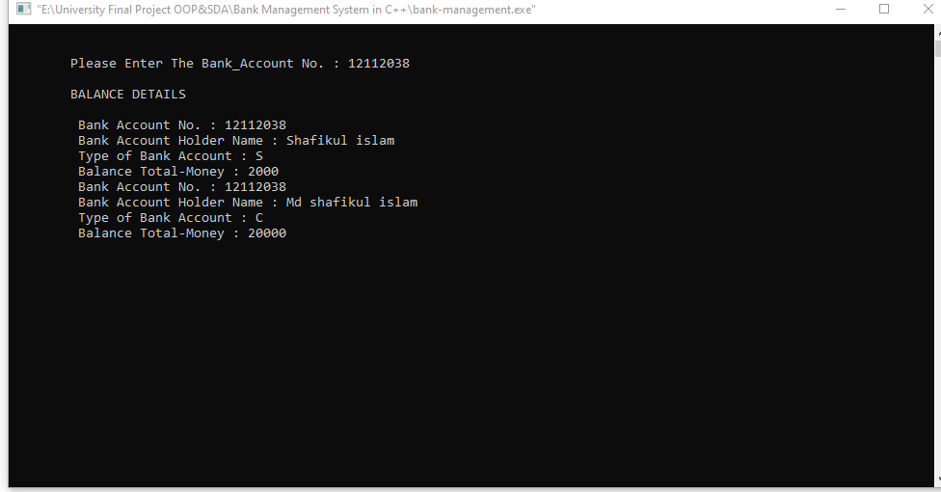
Bank Management System
Page 12
Balance Check by the customer
Display list of a customer account details comprising account number, name, and balance amount.

Slide 13
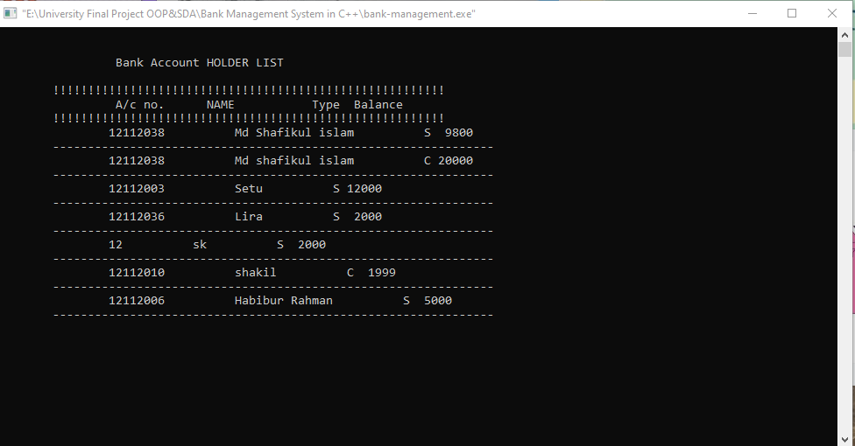
Bank Management System
Page 13
Show All Account holder’s List
Displays the list of all account details comprising of an account number, name, and balance amount.

Slide 14
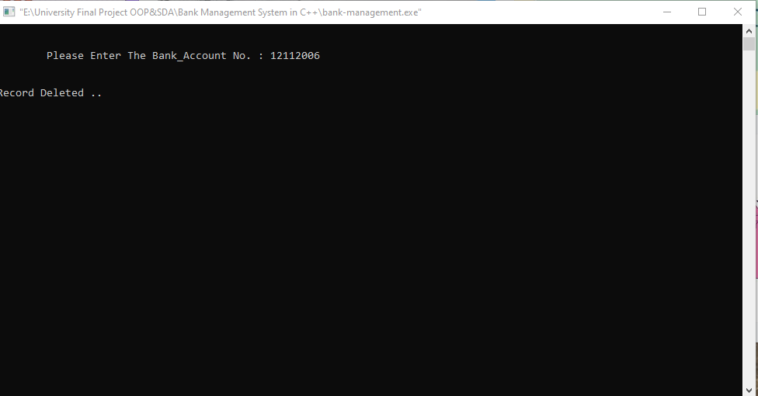

Bank Management System
Page 14
Closing a bank account
Cancels the selected account from the bank.

Slide 15

Bank Management System
Page 15
Modify or Updating the bank account
Selecting this allows modifying by accepting input such as account number, name, and amount.

Slide 16
Bank Management System
Page 16
Features Scope of the Project
Two different type login system user and admin
Admin can edit, cancel account holder information
Transfer Balance
Help Features add
Database using SQL
Translation History

Slide 17
Bank Management System
Page 17
EMAIL
shafikul1170@gmail.com
Got any questions?
MOBILE
+8801746711170
MAILING ADDRESS
Barishal,Bangladesh

Slide 18

Bank Management System
Thank You
Presented by Md Shafikul Islam

